Slide 1

Spatial Analysis and Maps with Python
PyCon 2018 Tutorial
5/10/2018
Christy Heaton

Slide 2






About me:
Email: christyheaton@gmail.com
Twitter: @christytoes
Website: christyheaton.github.io
Notes:
Add more

Slide 3
PyCon 2018
Intro to Spatial Analysis and Maps with Python
Novice-level
Expecting some Python knowledge but no GIS
https://us.pycon.org/2018/schedule/presentation/65/

Slide 4
9:00am Introduction to GIS, Maps, and Python
Answer questions, finish up Lunch at 12:20
Break at 10:15 (20 mins)
15 mins
45 mins
30 mins
80 mins
30 mins
20 mins
Go through workshop exercises
Notes:
I will check in, but say something if you fall behind

Slide 5
Setup
Go here:
https://github.com/christyheaton/PyCon2018_GISTutorial
Setup instructions are in the README.
Notes:
Get everyone set up

Slide 6
Let’s Talk About Maps
Notes:
Before we talk about what GIS is, let’s talk about why

Slide 7

Maps are Useful
https://washington-org.s3.amazonaws.com/s3fs-public/styles/editorial_wide/public/wmata-metro-map.jpg

Slide 8
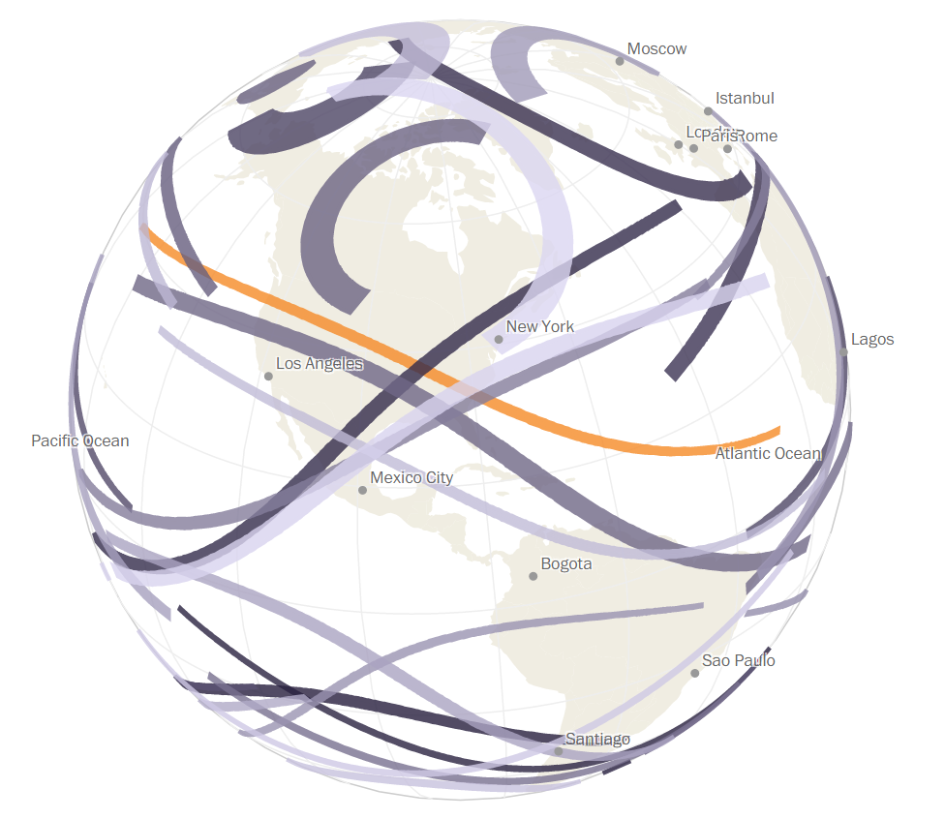
Maps are Cool
https://www.washingtonpost.com/graphics/national/eclipse/?utm_term=.d2cc157c8de0

Slide 9
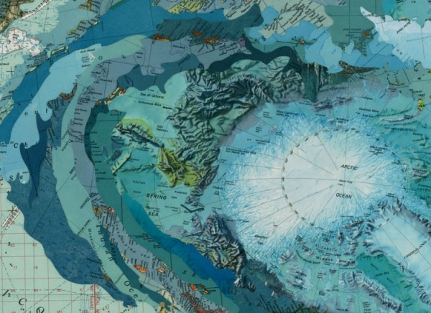
Maps are Beautiful
http://1.bp.blogspot.com/-zgKh_iUR1lI/UNJRIdDbZaI/AAAAAAAAIlY/GfBxUOZ3Rd0/s1600/Matthew-Cusick_trendland_2-600x436.jpg

Slide 10
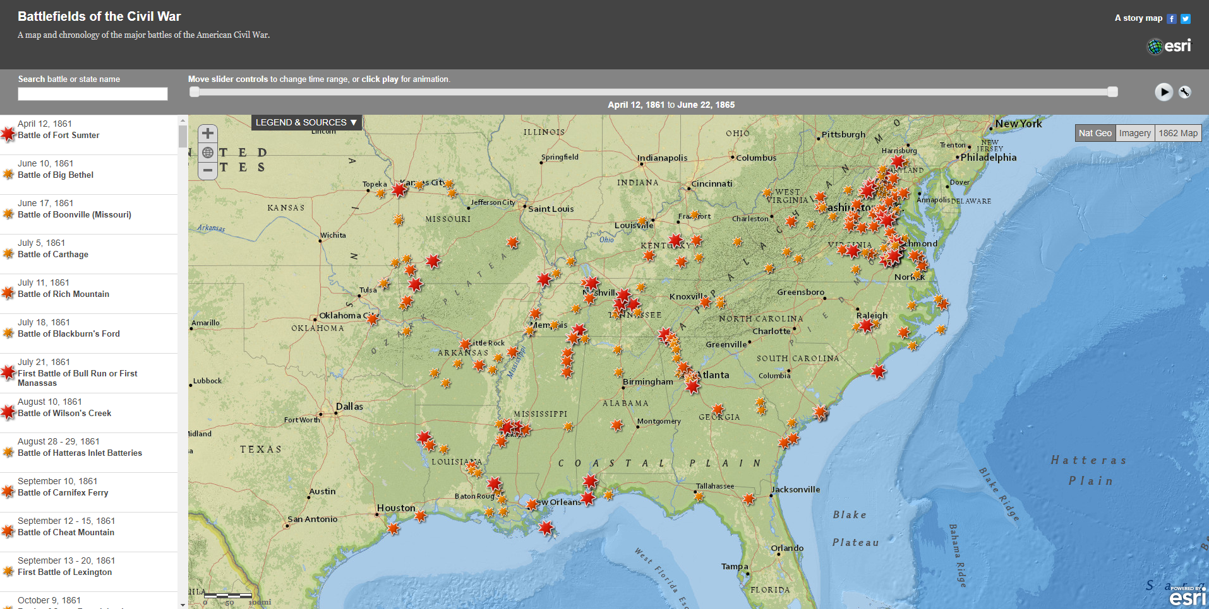
Maps Tell a Story
http://storymaps.esri.com/stories/civilwar

Slide 11

We Use Maps All The Time
http://cdn-media-1.lifehack.org/wp-content/files/2014/12/Les-multiples-services-de-Waze.png

Slide 12
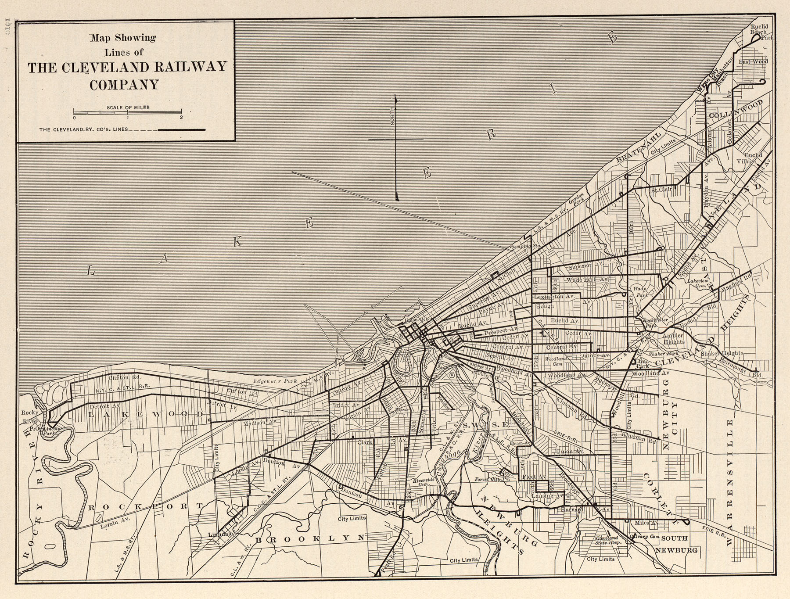
Maps Have Been Around a While
https://legacy.lib.utexas.edu/maps/historical/txu-oclc-6445490-electric_railway-cleveland-1913.jpg

Slide 13
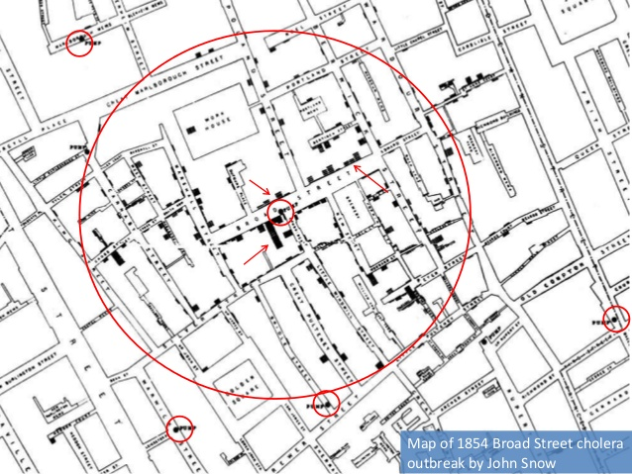
Mapping for Problem Solving
https://image.slidesharecdn.com/130409-financial-networkscrc-130411091407-phpapp02/95/financial-networks-and-cartography-2-638.jpg?cb=1365671703

Slide 14
“Hasn’t Everything Already Been Mapped?”

Slide 15
“Hasn’t Everything Already Been Mapped?”
Not possible

Slide 16
Let’s Make a Distinction
Base maps - used for reference
Thematic maps - have a theme

Slide 17
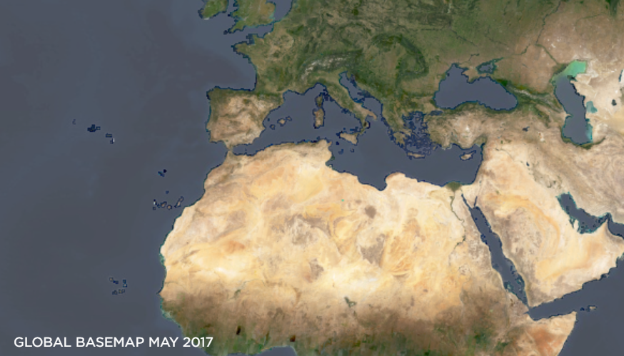
Base Maps
https://www.planet.com/products/basemap

Slide 18
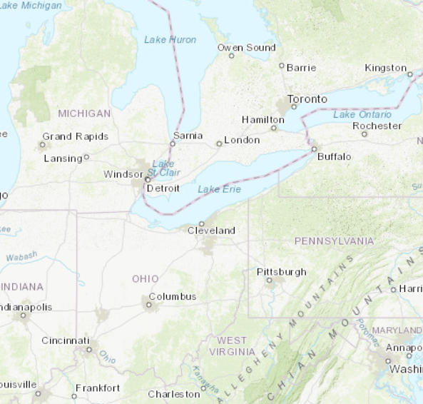
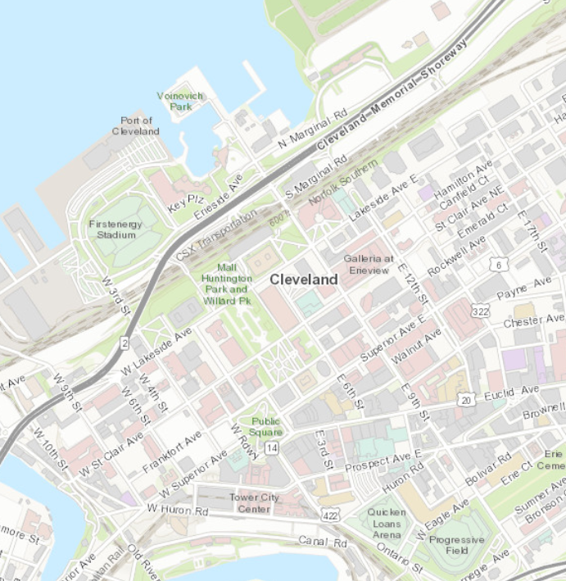
Base Maps
1:7,500,000
1:15,000
Esri, 2018

Slide 19
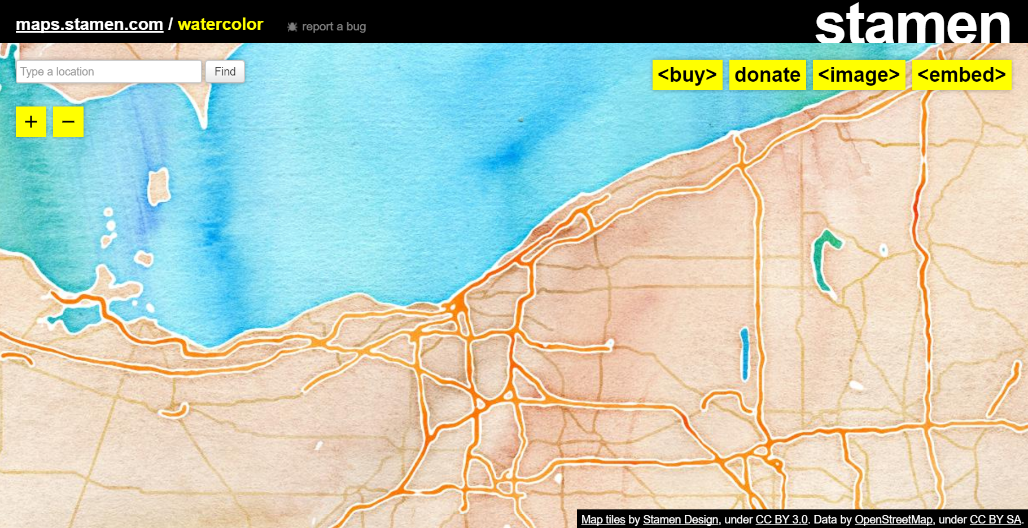
Base Maps
http://maps.stamen.com/watercolor/#9/41.6185/-81.5048

Slide 20
Base Maps
Changes in landscapes and infrastructure

Slide 21
Base Maps
Changes in landscapes and infrastructure
Different colors

Slide 22
Base Maps
Changes in landscapes and infrastructure
Different colors
Different scales

Slide 23
Base Maps
Changes in landscapes and infrastructure
Different colors
Different scales
Different features

Slide 24
Thematic Maps
A map with a theme

Slide 25
Thematic Maps
A map with a theme
The theme is there, but would not be seen from above

Slide 26
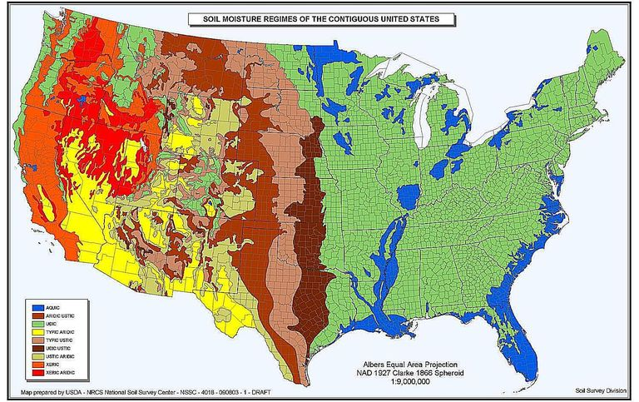
Thematic Maps
https://www.thoughtco.com/thematic-maps-overview-1435692

Slide 27
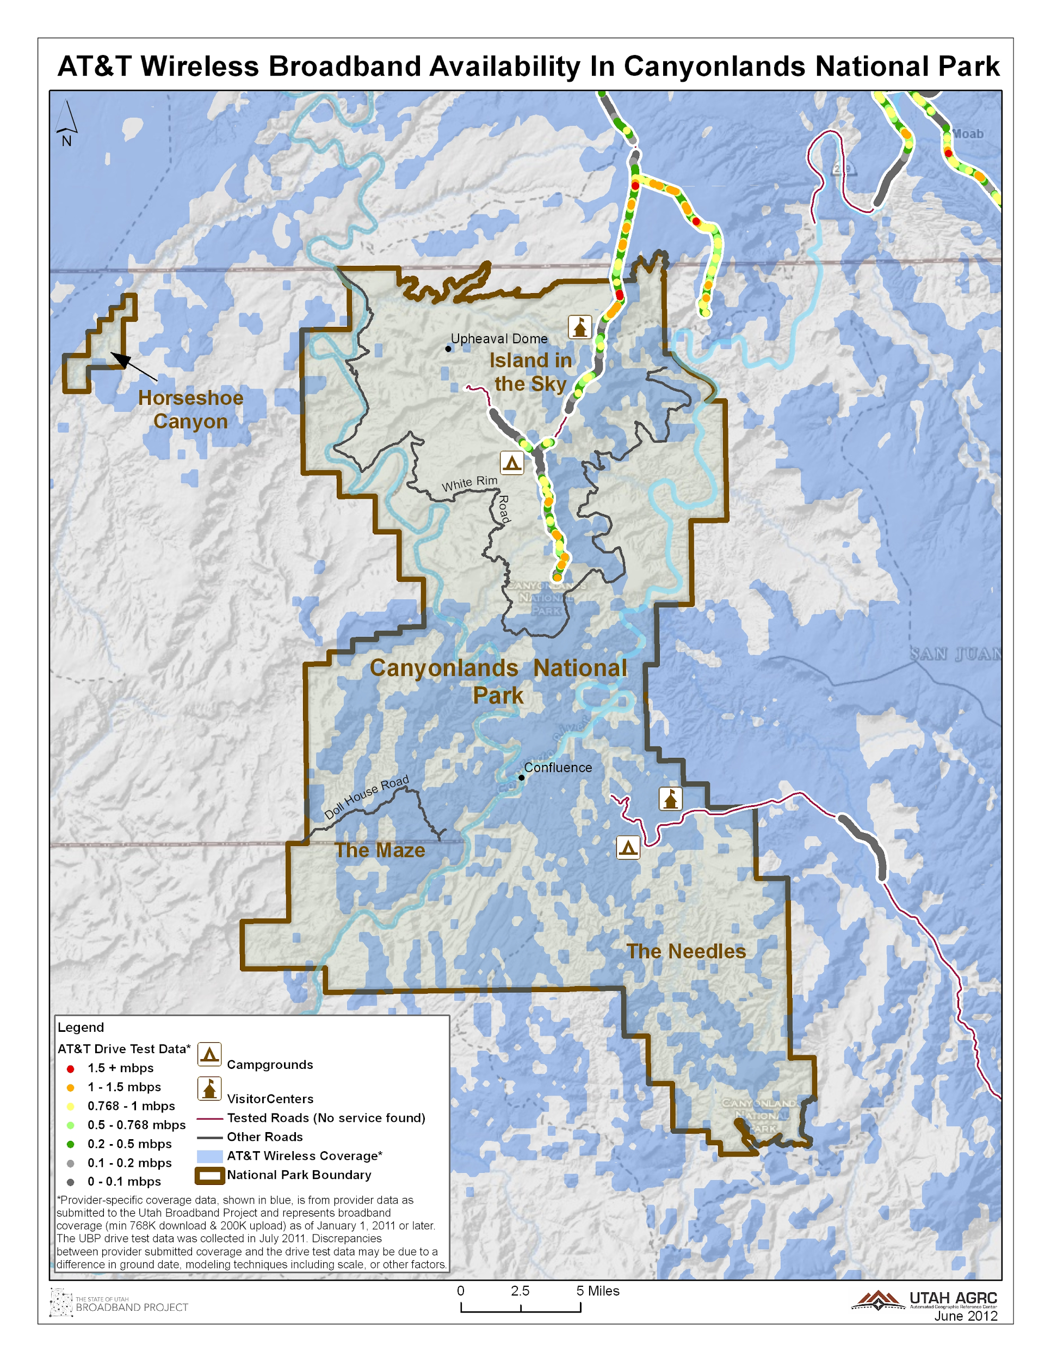
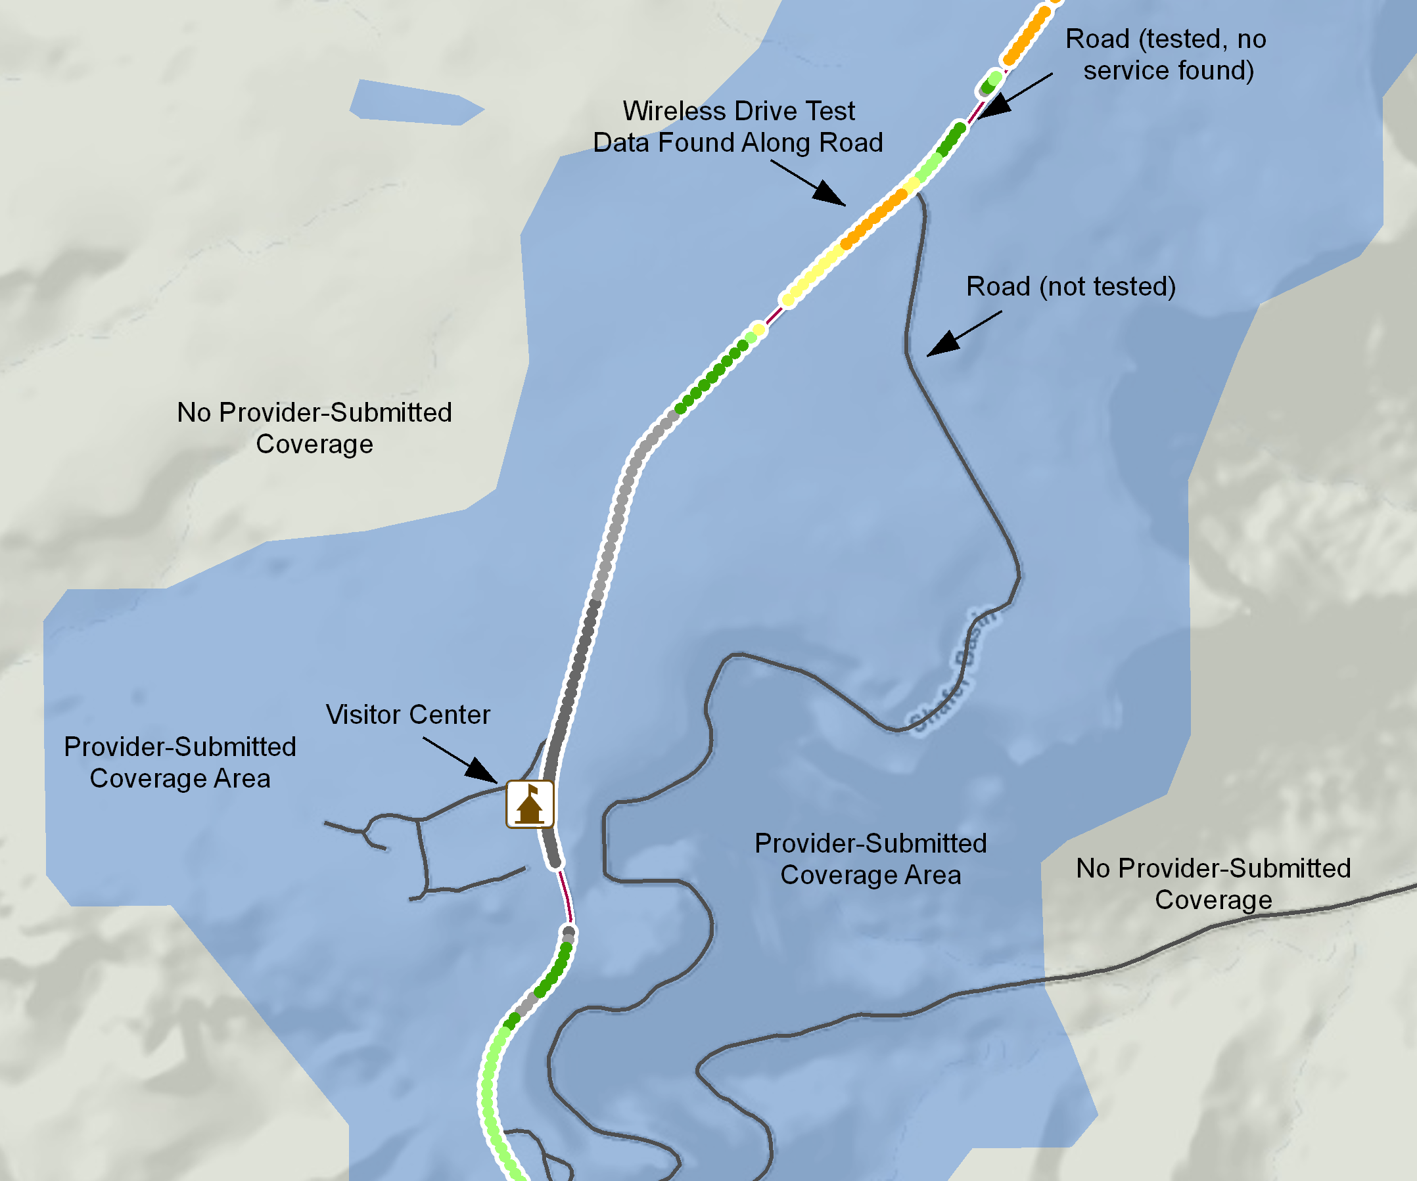
Thematic Maps
https://broadband.utah.gov/wp-content/uploads/2013/02/zion1.pdf

Slide 28
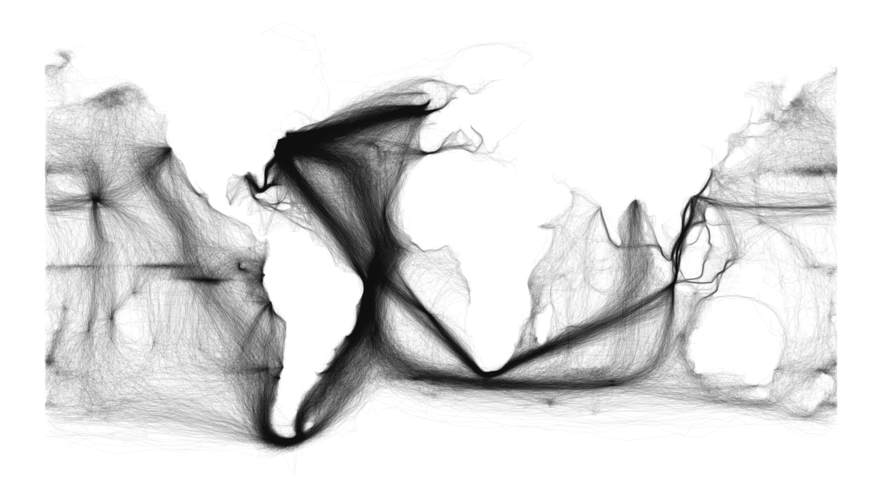
Thematic Maps
http://sappingattention.blogspot.com/2012/11/reading-digital-sources-case-study-in.html

Slide 29
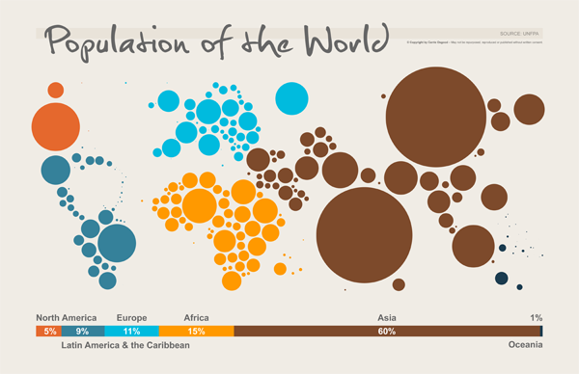
Thematic Maps
https://mir-s3-cdn-cf.behance.net/project_modules/disp/5127ee21354761.560441ee3d21a.png

Slide 30
Thematic Maps
Infinite themes to be mapped and spatial questions to ask

Slide 31
Thematic Maps
Infinite themes to be mapped and spatial questions to ask
We make maps with GIS

Slide 32
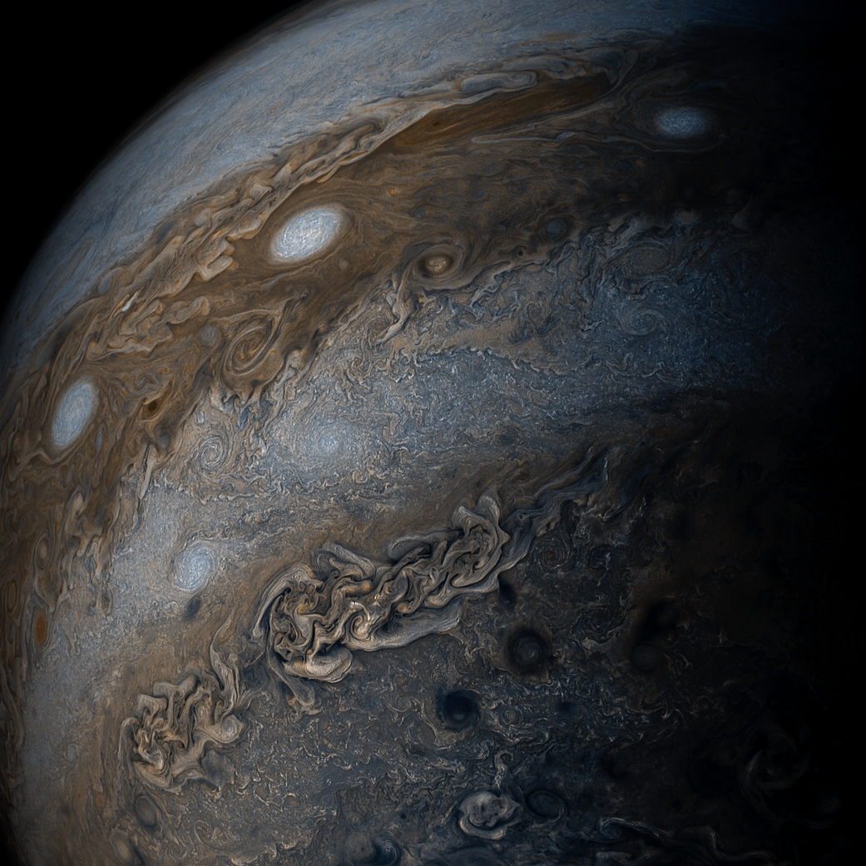

Non-Earth Maps
https://www.nasa.gov/image-feature/jpl/pia21334/saturnian-dawn
http://space-facts.com/wp-content/uploads/mars.jpg

Slide 33
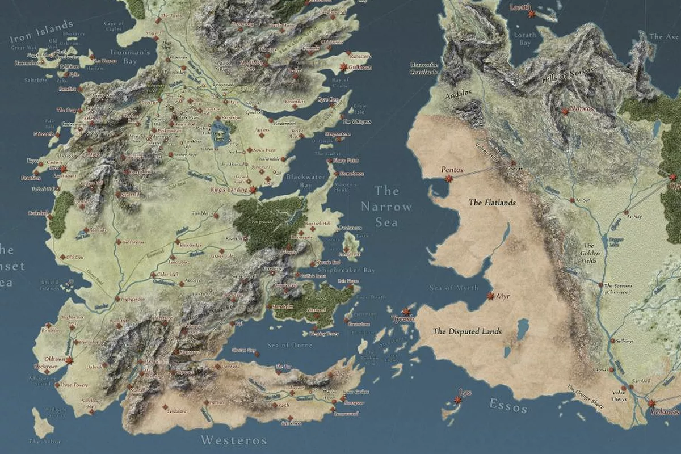

Non-Earth Maps
http://ksassets.timeincuk.net/wp/uploads/sites/55/2017/07/Game-of-Thrones-opening-sequence-Winterfell-920x584.jpg
https://www.polygon.com/2016/7/4/12093570/game-of-thrones-map-westeros

Slide 34
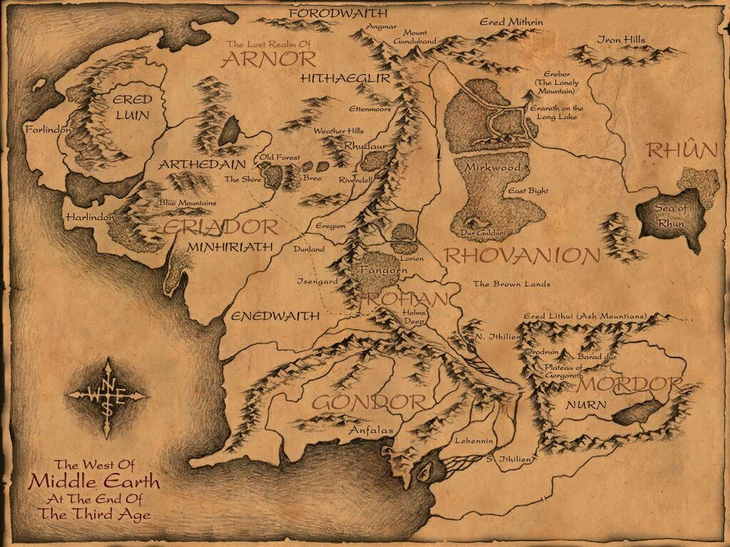
Non-Earth Maps
https://vignette3.wikia.nocookie.net/lotr/images/7/72/Middleearthmap.jpg/revision/latest?cb=20100402045252

Slide 35
What is GIS?

Slide 36
What is GIS?
A system that allows you to visualize, question, analyze, and interpret data to understand spatial relationships, patterns, and trends.

Slide 37
What is GIS?
A system that allows you to visualize, question, analyze, and interpret data to understand spatial relationships, patterns, and trends.
GIS is widely used in organizations of all sizes and in almost every industry.

Slide 38
What is GIS?
A system that allows you to visualize, question, analyze, and interpret data to understand spatial relationships, patterns, and trends.
GIS is widely used in organizations of all sizes and in almost every industry.
A mix of data, science, analysis, and maps.

Slide 39
We Use GIS to Answer Where Questions

Slide 40
We Use GIS to Answer Where Questions
Where is the zoo and how do we get there?
Notes:
Can all be rewritten to actual where questions

Slide 41
We Use GIS to Answer Where Questions
Where is the zoo and how do we get there?
Where are traffic conditions best right now?
Notes:
Can all be rewritten to actual where questions

Slide 42
We Use GIS to Answer Where Questions
Where is the zoo and how do we get there?
Where are traffic conditions best right now?
Where will I be able to go to see the solar eclipse?
Notes:
Can all be rewritten to actual where questions

Slide 43
We Use GIS to Answer Where Questions
Where is the zoo and how do we get there?
Where are traffic conditions best right now?
Where will I be able to go to see the solar eclipse?
Where should we build a store/wind turbine/solar panel?
Notes:
Can all be rewritten to actual where questions

Slide 44
We Use GIS to Answer Where Questions
Where is the zoo and how do we get there?
Where are traffic conditions best right now?
Where will I be able to go to see the solar eclipse?
Where should we build a store/wind turbine/solar panel?
Where would nitrogen and phosphorus runoff be affected if there are changes in infrastructure?
Notes:
Can all be rewritten to actual where questions

Slide 45
We Use GIS to Answer Where Questions
Where is the zoo and how do we get there?
Where are traffic conditions best right now?
Where will I be able to go to see the solar eclipse?
Where should we build a store/wind turbine/solar panel?
Where would nitrogen and phosphorus runoff be affected if there are changes in infrastructure?
Where will the hurricane hit and what cities will be impacted?
Notes:
Can all be rewritten to actual where questions

Slide 46
We Use GIS to Answer Where Questions
Where is the zoo and how do we get there?
Where are traffic conditions best right now?
Where will I be able to go to see the solar eclipse?
Where should we build a store/wind turbine/solar panel?
Where would nitrogen and phosphorus runoff be affected if there are changes in infrastructure?
Where will the hurricane hit and what cities will be impacted?
Where should we place advertisements so that people see them who are most likely to buy our product?
Notes:
Can all be rewritten to actual where questions

Slide 47
We Use GIS to Answer Where Questions
Where is the zoo and how do we get there?
Where are traffic conditions best right now?
Where will I be able to go to see the solar eclipse?
Where should we build a store/wind turbine/solar panel?
Where would nitrogen and phosphorus runoff be affected if there are changes in infrastructure?
Where will the hurricane hit and what cities will be impacted?
Where should we place advertisements so that people see them who are most likely to buy our product?
...
Notes:
Can all be rewritten to actual where questions

Slide 48
What Makes Up a GIS?
G
I
S

Slide 49
What Makes Up a GIS?
Geographic
Information
System

Slide 50
What Makes Up a GIS?
Geographic - Spatial
Information
System

Slide 51
What Makes Up a GIS?
Geographic - Spatial
Information - Attributes
System

Slide 52
What Makes Up a GIS?
Geographic - Spatial
Information - Attributes
System - All the moving parts

Slide 53
What Makes Up a GIS?
Geographic - Spatial
Information - Attributes
System - All the moving parts
A system that allows you to store, process, and visualize information with a spatial component.

Slide 54

What Makes Up a GIS?
People
Methods
Data
Software
Hardware
https://previews.123rf.com/images/naschy/naschy1611/naschy161100009/67318622-Vector-Illustration-of-GIS-Spatial-Data-Layers-Concept-for-Business-Analysis-Geographic-Information--Stock-Vector.jpg

Slide 55
5. People
Users and creators of the GIS
Asking questions
Designing methods
Making maps
Sharing/Deploying maps and mapping applications

Slide 56
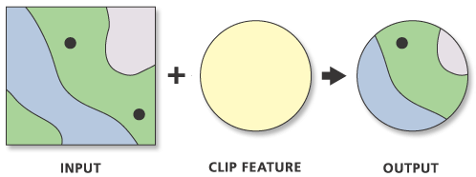
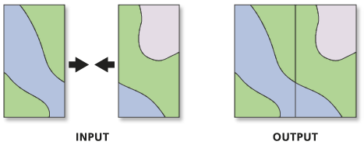
4. Analysis/Methods
Buffer
Clip
Transform
http://pro.arcgis.com/en/pro-app/tool-reference/data-management/GUID-AF3DF698-56D0-4BE3-946D-0089F91EC1A3-web.png

Slide 57
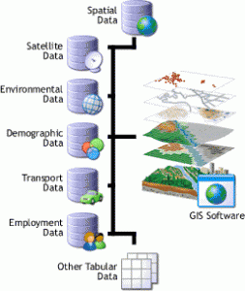
3. Data
Files/Database
Spatial characteristics
Multiple sources
http://www.whatisgis.com/wp-content/uploads/2012/06/gis_dbSoftware-253x300.gif
Notes:
Add table show spatial column

Slide 58




2. Software
Operating System
Mapping Application

Slide 59

Hardware
Computers/Servers
Scanner
Plotter
GPS Unit
https://mind42.com/public/7281a3b5-0cc5-462c-bc92-5d53439e6b57

Slide 60
Maps
The way we display GIS data
https://www.thoughtco.com/thematic-maps-overview-1435692

Slide 61
Web Maps
Base Maps
Thematic Layers
Interactive/Dynamic Map elements
Tiles (raster and vector)
Caching
Live Data Sources
Web Services

Slide 62

What Makes GIS Data Different?
Things to Consider
http://www.pngall.com/wp-content/uploads/2016/06/Earth-PNG-Pic.png

Slide 63
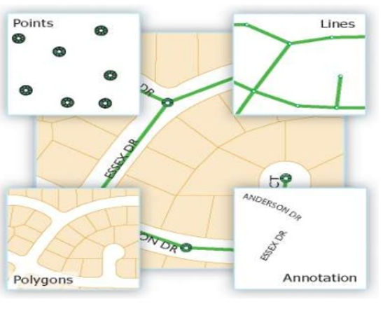
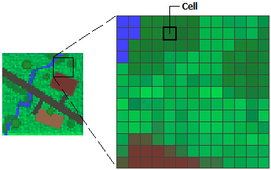
Vector/Raster
Vector - discrete entities: points, lines, and polygons
Raster - images consisting of regularly sized and spaced cells where every cell has a value
https://image.slidesharecdn.com/introductiontogis-151109064609-lva1-app6891/95/introduction-to-gis-15-638.jpg?cb=1447383776
http://desktop.arcgis.com/en/arcmap/10.3/manage-data/raster-and-images/GUID-6754AF39-CDE9-4F9D-8C3A-D59D93059BDD-web.png
Notes:
For a county - only a few points will be stored

Slide 64
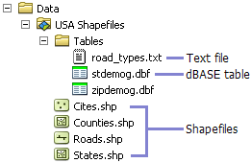
Vector
https://previews.123rf.com/images/naschy/naschy1611/naschy161100009/67318622-Vector-Illustration-of-GIS-Spatial-Data-Layers-Concept-for-Business-Analysis-Geographic-Information--Stock-Vector.jpg
http://desktop.arcgis.com/en/arcmap/10.3/manage-data/shapefiles/GUID-AFEE52B3-BBE8-4F33-A55B-5CFD5106B80C-web.png
Notes:
Show data attribute table and spatial component

Slide 65
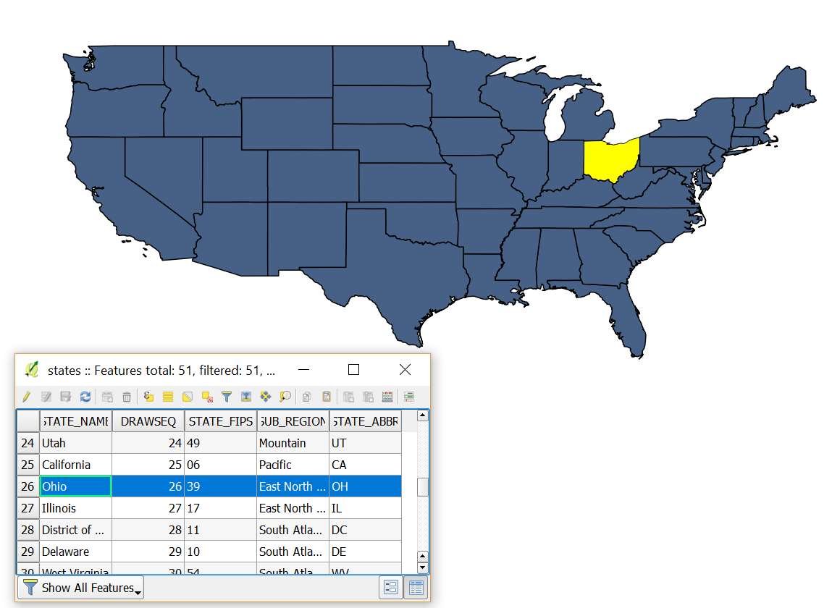
Vector
Esri State Data
Notes:
Show data attribute table and spatial component

Slide 66

Raster
Digital Elevation Model
One elevation value per cell
http://igic.org/news/media/5/elevation.jpg

Slide 67
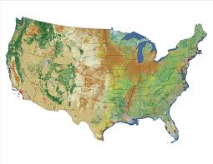
Raster
National Landcover Database
One land cover designation per cell
https://www.mrlc.gov/nlcd06_data.php

Slide 68
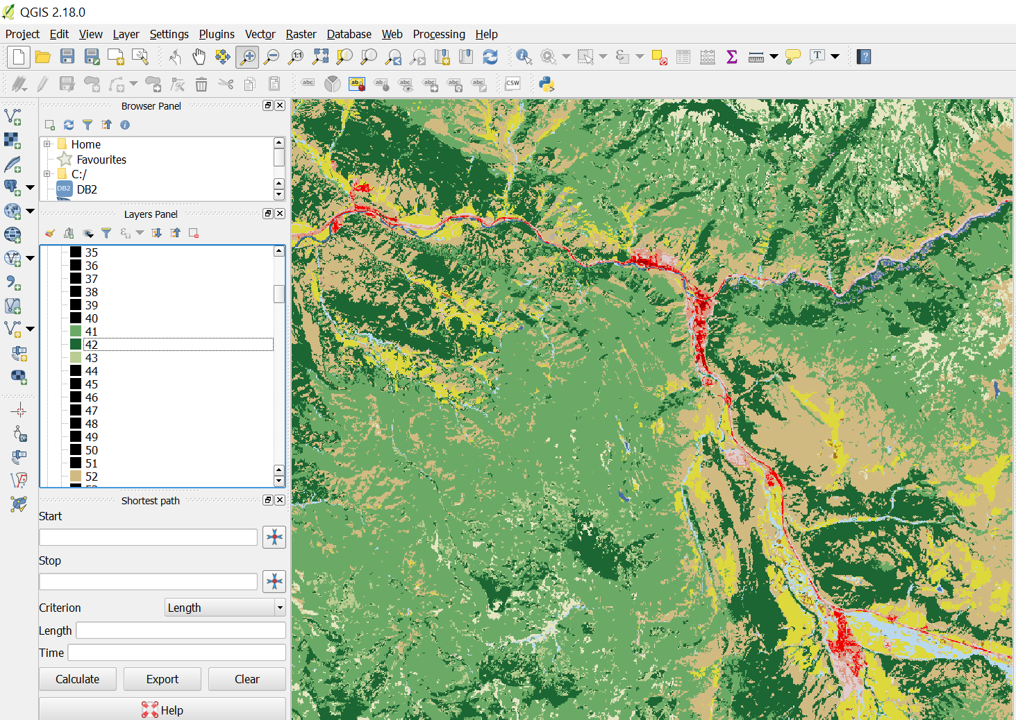
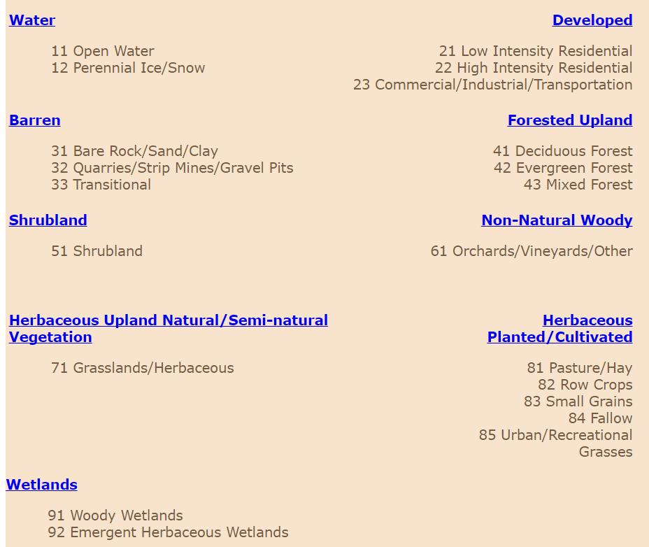
Raster
https://landcover.usgs.gov/classes.php

Slide 69
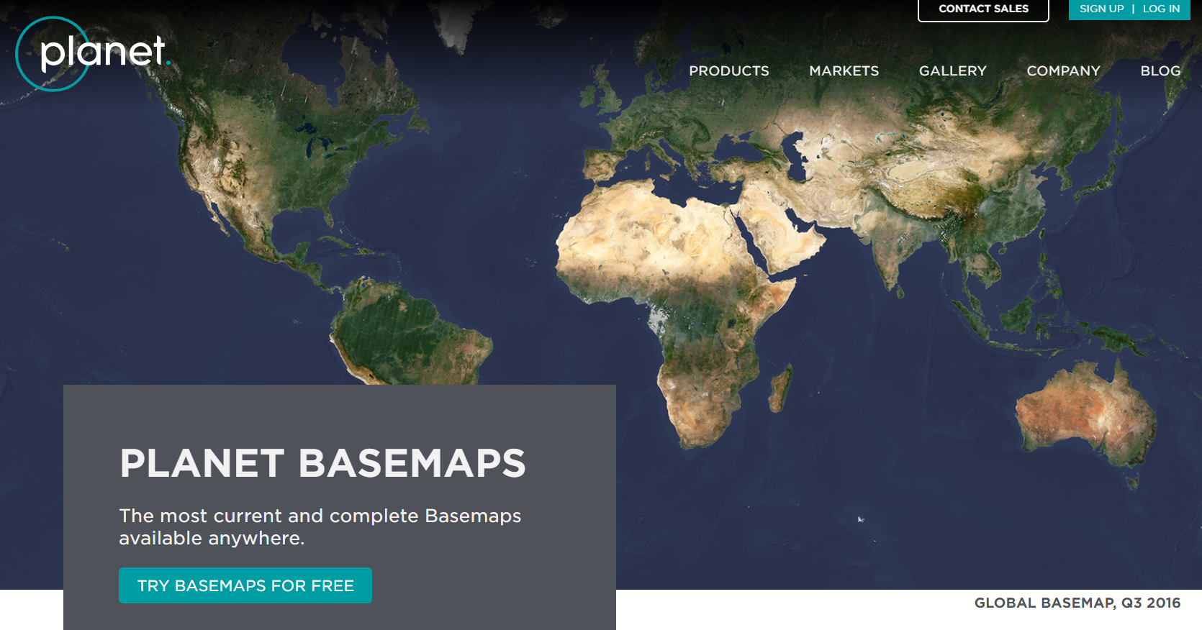
Aerial Imagery
https://www.planet.com/products/basemap

Slide 70



Data Acquisition
Not all data exists
May be costly or difficult
Lots of data is available

Slide 71
Common Data Sources
Government
Census
Crowd sourced
Proprietary

Slide 72
Data Quality
Know your source
Trust your source
Cite your source

Slide 73
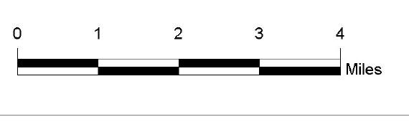
Scale
How many inches represent 1 mile?
How much information do you show?
At what scales?

Slide 74
Remember Base Maps
1:7,500,000
1:15,000
Esri, 2018

Slide 75
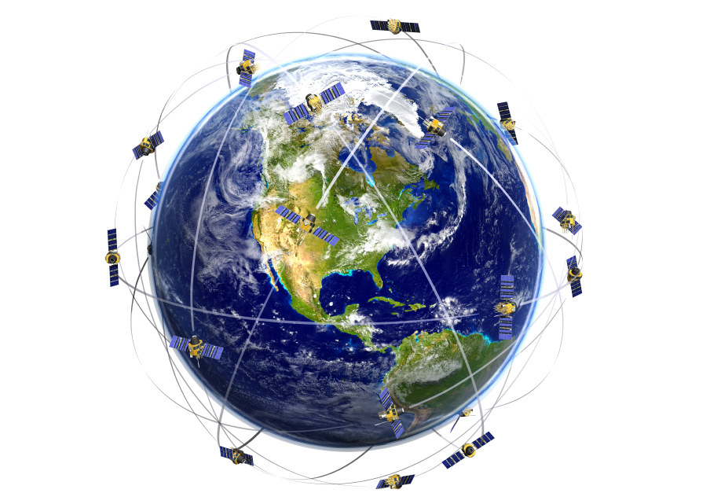
Data Collection and GPS
http://www.figonet.com/wp-content/uploads/2013/12/science-of-gps.jpg

Slide 76
The Earth is Not Flat
http://www.pngall.com/wp-content/uploads/2016/06/Earth-PNG-Pic.png

Slide 77
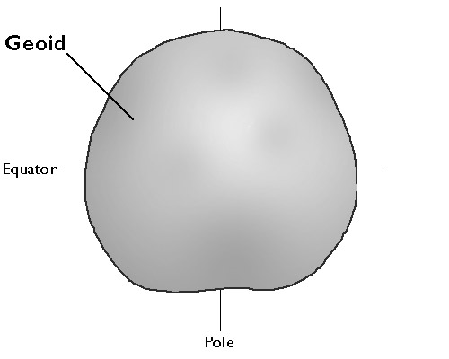
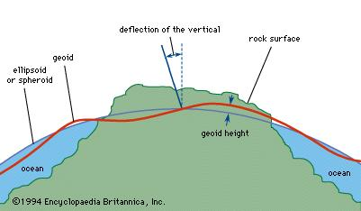
Geoid
https://www.e-education.psu.edu/natureofgeoinfo/sites/www.e-education.psu.edu.natureofgeoinfo/files/image/geoid_diagram.jpg
https://media1.britannica.com/eb-media/67/467-004-E3A4C9EC.jpg

Slide 78
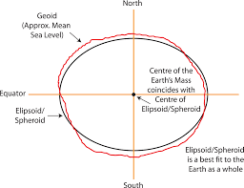
Ellipsoid
http://www.icsm.gov.au/mapping/datums1.html

Slide 79
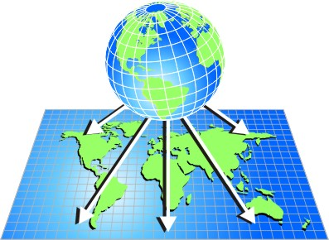
Projections
http://www.statcan.gc.ca/pub/92-195-x/2011001/other-autre/mapproj-projcarte/images/m-c.jpg

Slide 80
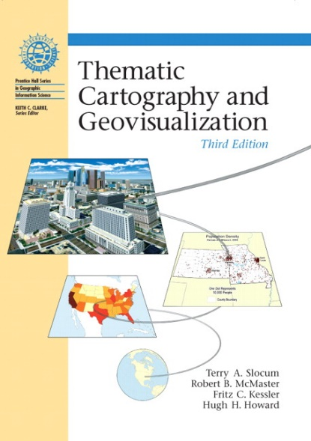
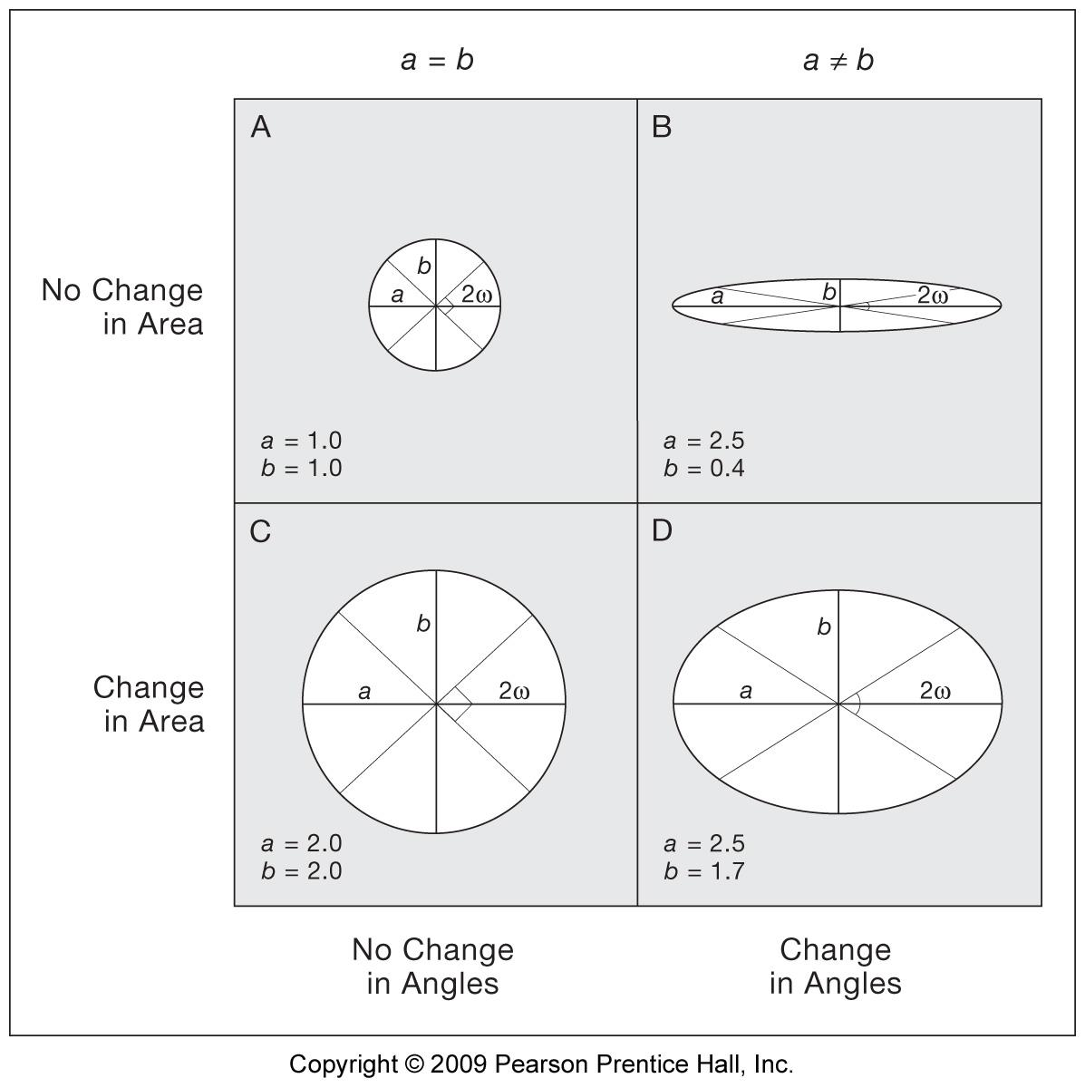
Projection Distortion
Area
Angles
Shape
Distance
Direction
Slocum, Terry A., Robert B. McMaster, Fritz C. Kessler, and Hugh H. Howard. 2009. Thematic Cartography and Geovisualization. 3rd Edition. Upper Saddle River, NJ: Pearson Prentice Hall.

Slide 81

Projections

Slide 82
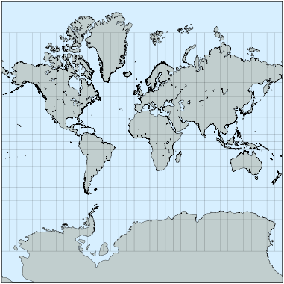
The World Mercator Projection EPSG:3395
Straight lines across oceans made for sea navigation
Used in web maps
Distorted at the poles
http://www.progonos.com/furuti/MapProj/Normal/ProjNav/Img/mp_Mercator-s60.png

Slide 83
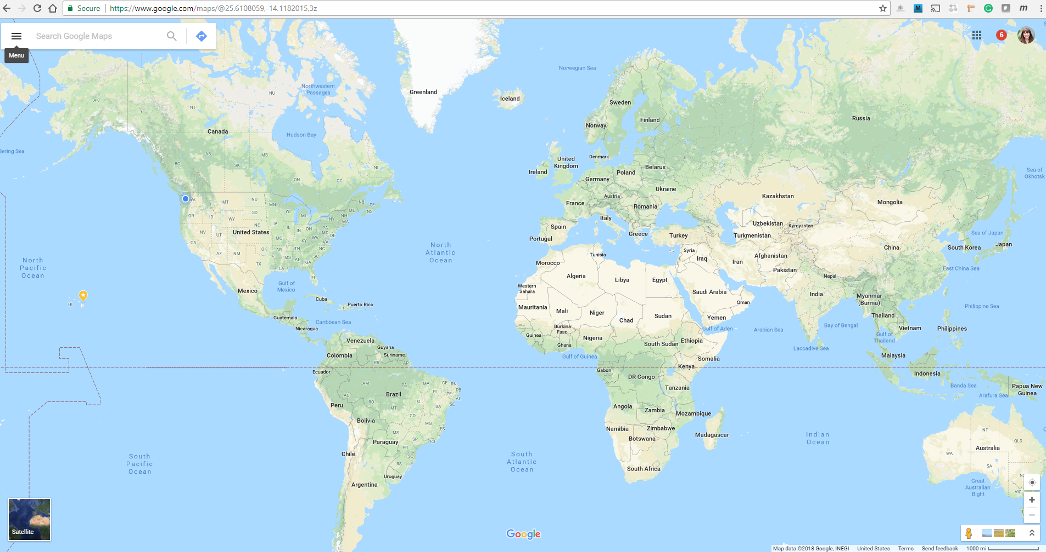
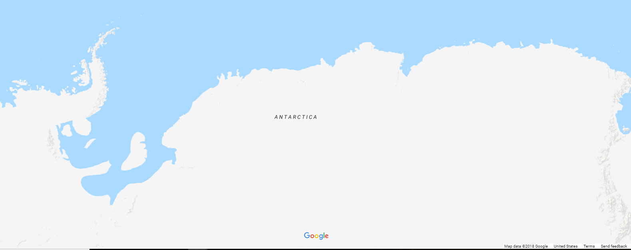
The World Mercator Projection EPSG:3395
maps.google.com

Slide 84
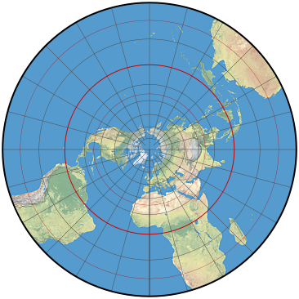
The Polar Stereographic Projection EPSG:3995
Only the center is true to scale
https://www.mapthematics.com/ProjectionsList/Projectioninfo/stereographic-map.png

Slide 85
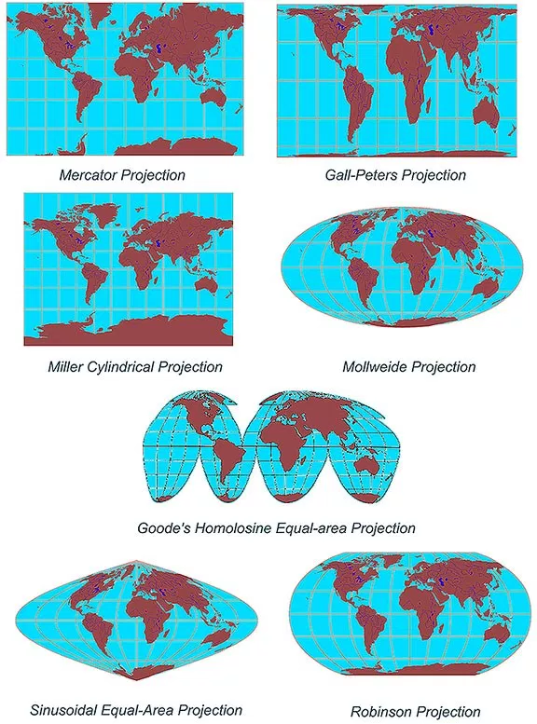
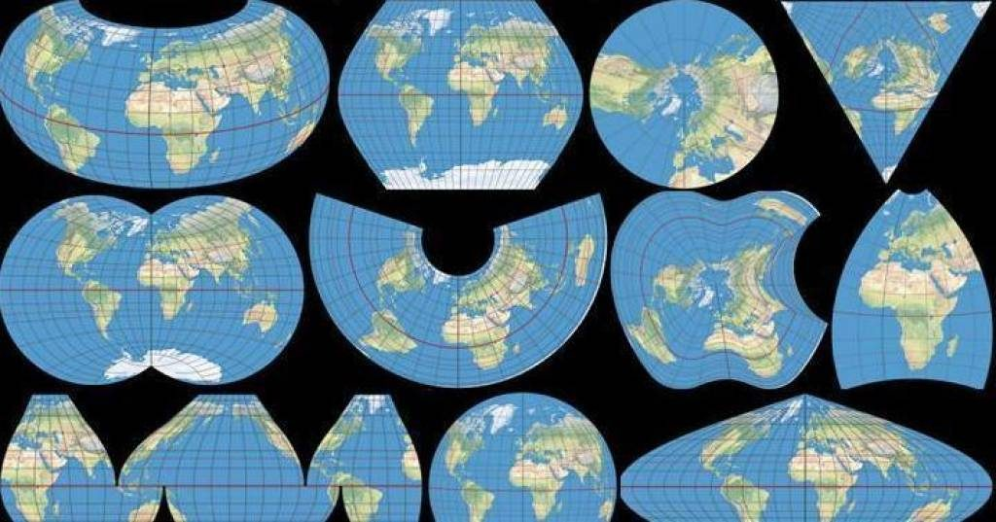
Other Map Projections
http://ahasanulhoque.com/wp-content/uploads/2017/04/map-projections-u1-1024x537-1024x537.jpg
https://i2.wp.com/geoawesomeness.com/wp-content/uploads/2013/09/projections.jpg

Slide 86
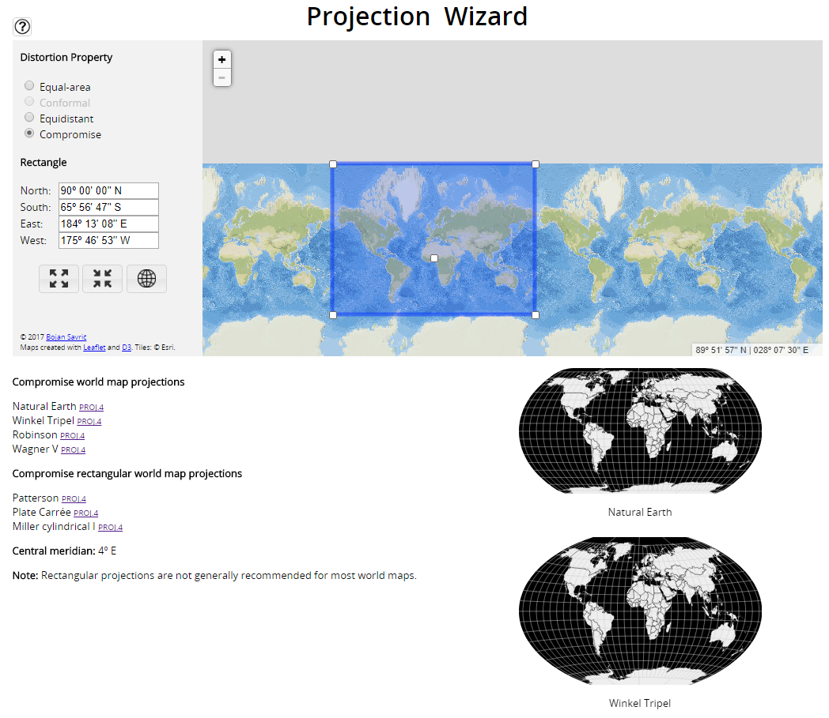
Map Projection Tools
http://projectionwizard.org/

Slide 87
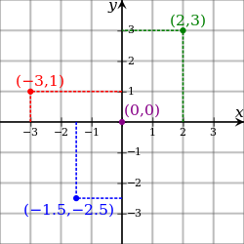
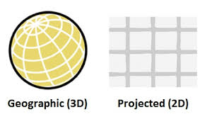
Coordinate Systems
How we define a location
Geographic/Unprojected
Projected
https://upload.wikimedia.org/wikipedia/commons/thumb/0/0e/Cartesian-coordinate-system.svg/250px-Cartesian-coordinate-system.svg.png
https://static1.squarespace.com/static/55bb8935e4b046642e9d3fa7/55bb8e8ee4b03fcc125a74c0/55bb8e91e4b03fcc125a7a66/1326905027513/1000w/coordinate_systems.jpg

Slide 88
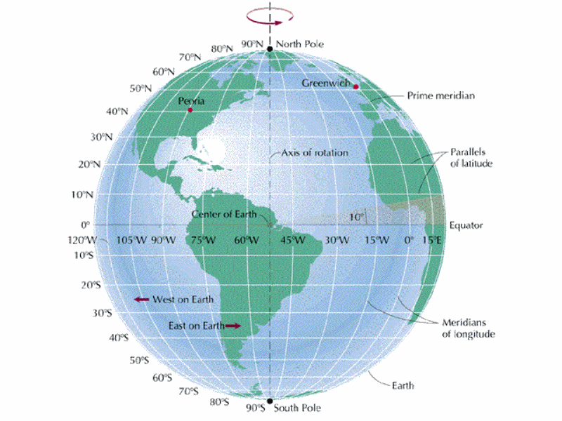
WGS84 Geographic/Unprojected Coordinate System
Latitude, Longitude
Used by GPS to express locations on the earth, and GeoJSON
EPSG:4326
Cleveland, OH
41.4993° N, 81.6944° W
http://www.mymanatee.org/.imaging/stk/mcg-mymanatee/zoom/dms/departments/information-services/gis/gis-stage-images/EarthLatLong/document/EarthLatLong.gif

Slide 89
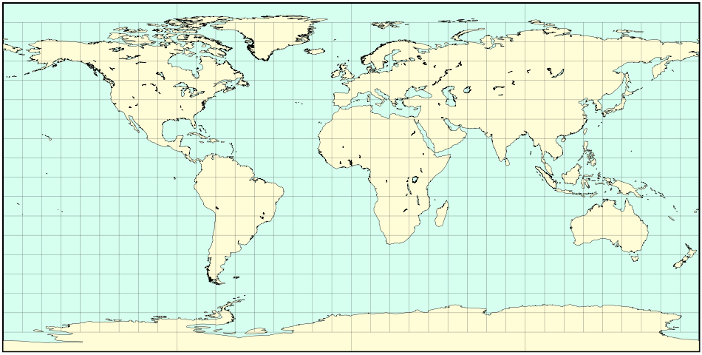
WGS84 Geographic/Unprojected Coordinate System
Usually projected in Plate-Carrée, which creates a linear Cartesian graph on the page
http://www.mymanatee.org/.imaging/stk/mcg-mymanatee/zoom/dms/departments/information-services/gis/gis-stage-images/EarthLatLong/document/EarthLatLong.gif

Slide 90
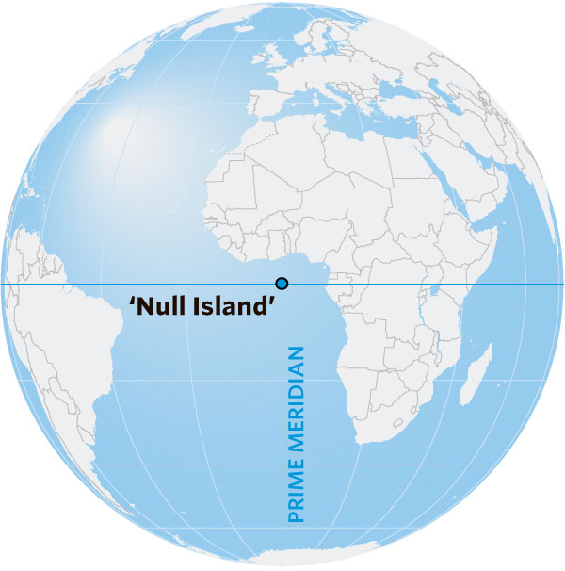



WGS84 Geographic/Unprojected Coordinate System
https://www.vicchi.org/wp-content/uploads/2014/04/null_island.jpg
https://si.wsj.net/public/resources/images/BN-OW822_backgr_1_20160713091316.jpg

Slide 91
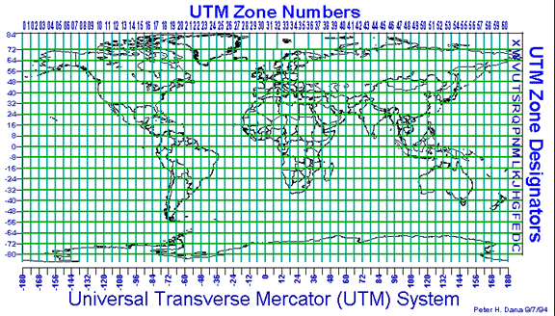
The Universal Transverse Mercator Coordinate System
Separated into 60 zones
Uses a transverse mercator projection
http://gis.depaul.edu/shwang/teaching/geo381/LN4_files/image039.gif

Slide 92
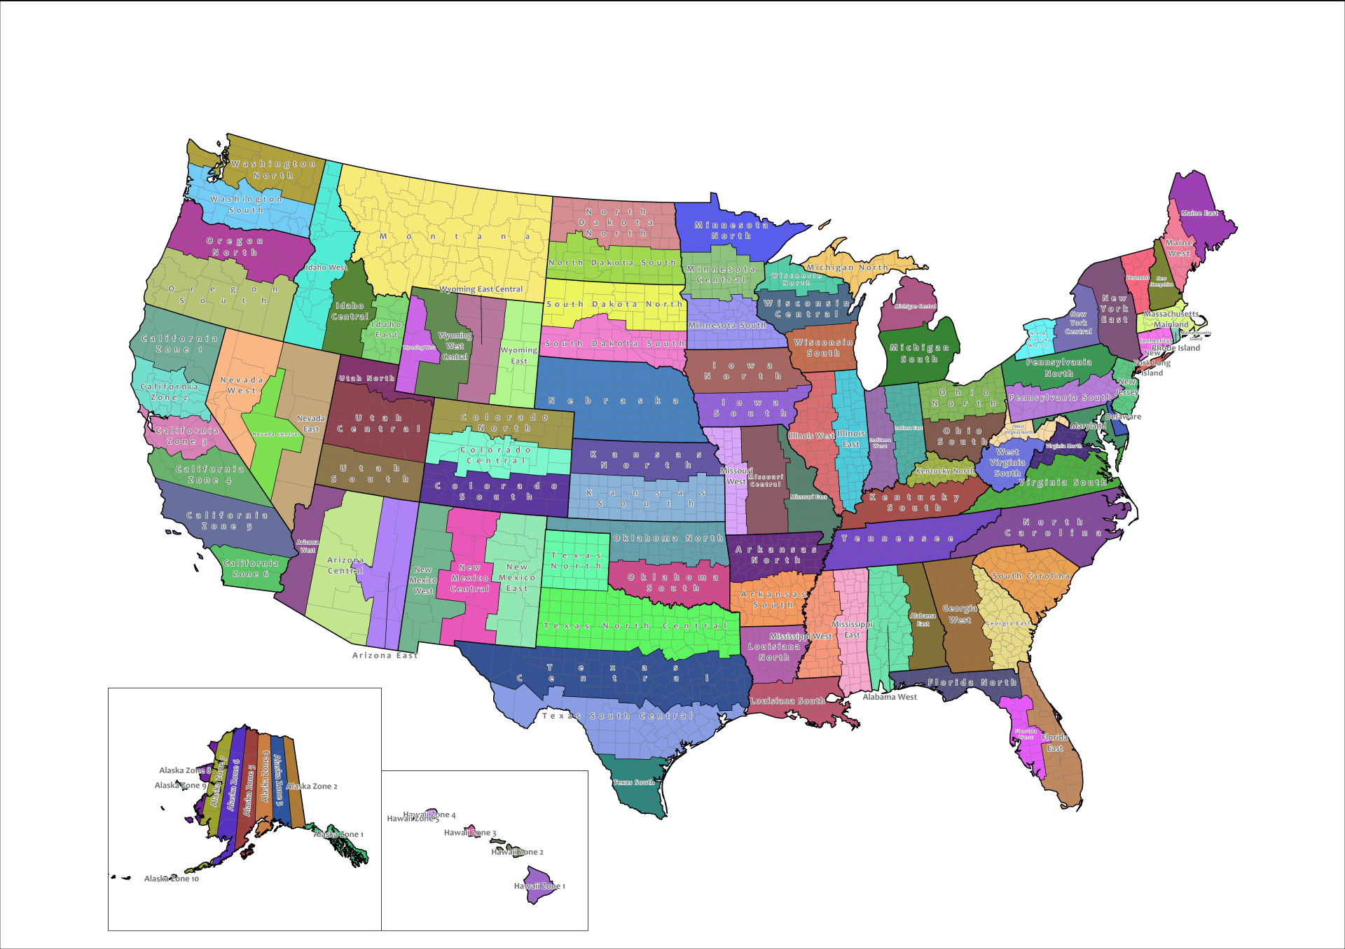
The State Plane Coordinate System
Optimized for states and zones
Projections vary
http://www.edc.uri.edu/nrs/classes/nrs409509/Lectures/4MapBasics/SPZones.png

Slide 93
Maps Caveats
All models are wrong
Depending on the projection:
Sizes are not consistent
Lines are not straight lines
Areas are distorted
Data issues after processing
Maps can be used to intentionally mislead
Even a very good model is a simplification

Slide 94
This is Not How the World Looks
https://www.planet.com/products/basemap

Slide 95


Maps Can Be Used to Mislead
https://www.washingtonpost.com/news/monkey-cage/wp/2017/01/31/the-supreme-court-will-examine-partisan-gerrymandering-in-2017-that-could-change-the-voting-map/?utm_term=.6455d75cd19f
https://upload.wikimedia.org/wikipedia/commons/9/99/Illinois_District_4_2004.png

Slide 96

Maps Can Be Used to Mislead
“How to Lie with Maps”
http://tmm.chicagodistributioncenter.com/IsbnImages/9780226534213.jpg

Slide 97
Maps Can Be Used to Mislead
Choice of colors, color classifications, data, and aggregation units can make maps tell different stories

Slide 98

Use GIS
Understand our world
Answer spatial questions
Make beautiful visualizations
https://www.greatamericaneclipse.com/best-places-to-view

Slide 99
To Sum Up...

Slide 100
To Sum Up...
Maps are great visualizations

Slide 101
To Sum Up...
Maps are great visualizations
There’s a lot that goes into GIS

Slide 102
To Sum Up...
Maps are great visualizations
There’s a lot that goes into GIS
Spatial data is different

Slide 103
To Sum Up...
Maps are great visualizations
There’s a lot that goes into GIS
Spatial data is different
Think critically when using maps

Slide 104
To Sum Up...
Maps are great visualizations
There’s a lot that goes into GIS
Spatial data is different
Think critically when using maps
Use GIS to solve problems and make maps!

Slide 105





General purpose programming language
Free and open source
Has a wide variety of uses such as building applications, websites, statistics, calculations, data science, etc.

Slide 106
Python for GIS
Extend the capabilities of mapping applications
Build a GIS workflow
Automate redundant tasks
Integrate maps or spatial data into other applications
Build your own applications

Slide 107



Python Libraries for GIS
geo

Slide 108
Tools We Will Use Today
Spatial data
Python
Python libraries (Geopandas, etc)
Conda
Jupyter Notebook

Slide 109
Geopandas
“GeoPandas is an open source project to make working with geospatial data in Python easier. GeoPandas extends the datatypes used by pandas to allow spatial operations on geometric types. Geometric operations are performed by shapely. Geopandas further depends on fiona for file access and descartes and matplotlib for plotting.”
-http://geopandas.org/

Slide 110
Conda
Package management system and environment management system
Tightly coupled with Anaconda and Miniconda

Slide 111
Anaconda and Miniconda
Anaconda - a Python distribution with over 1,000 open sources data science packages and Conda
Big - takes a long time to install
Creating our environment is faster because there are less dependencies to install
Miniconda - a Python distribution with just Conda and its dependencies
Small - quick to install
Creating our environment takes longer because there are more dependencies to install

Slide 112
Jupyter Notebook
An open source web application that allows you to create and share documents that contain live code, equations, visualizations and narrative text.
Uses include: data cleaning and transformation, numerical simulation, statistical modeling, data visualization, machine learning, and much more. (LIKE MAPPING)
-http://jupyter.org/

Slide 113
Why are we doing it this way?
Easy to demo a workflow
Compact and reproducible (used in academia, science)
Easy to customize and change
Easy to share your process with non-coders and non-GIS people

Slide 114
Workshop Time!
Go here:
https://github.com/christyheaton/PyCon2018_GISTutorial
Setup instructions are in the README.
https://github.com/christyheaton/PyCon2018_GISTutorial

Slide 115
Break Time
https://github.com/christyheaton/PyCon2018_GISTutorial

Slide 116
Base Maps
https://www.planet.com/products/basemap

Slide 117
OpenStreetMap (OSM)
A collaborative project to create a free editable map of the world
Like Google Maps
Like Wikipedia

Slide 118

Base Map Tiles
Usually regularly sized square 256×256 pixel images
Cover entire map area without gaps or overlap
Make your own or use existing ones

Slide 119

Let’s look at a tiled web map

Slide 120
Exercise 1: Call OpenStreetMap Tiles
Open Chrome developer tools
Go to openstreetmap.org or another map site
See tile URLs in the developer tools network
Copy a tile url and paste it a browser
Try a few!

Slide 121

Exercise 1: Call OpenStreetMap Tiles
http://a.tile.openstreetmap.org/5/18/9.png
http://b.tile.openstreetmap.org/7/68/41.png
http://a.tile.openstreetmap.org/7/65/43.png

Slide 122

Tile Identification
Z {Level}
X {Column}
Y {Row}
http://{s}.domain.com/{z}/{x}/{y}.png
http://tilehelper.azurewebsites.net/

Slide 123

A Web Map Has a Lot of Tiles!
t=0
for i in range(0,21):
t = t + ((2**i)**2)
print(t)
For 20 zoom levels that’s...

Slide 124
A Web Map Has a Lot of Tiles!
t=0
for i in range(0,21):
t = t + ((2**i)**2)
print(t)
For 20 zoom levels that’s 1,466,015,503,701 tiles!

Slide 125
Exercise 2: Tile levels
Pick a place in the Northern Hemisphere
Find its coordinates
Call the tile containing your location for levels 5, 10, & 15
Use this to help!

Slide 126

Exercise 2: Tile levels
Go here
Replace the lat/long in the url parameters with your own
Find a OSM tile url from Exercise 1
Replace the Z, X, and Y values with those in your table for levels 5, 10, and 15

Slide 127
Exercise 2: Tile levels
My Location: Madrid, Spain
Coordinates: 40.4, -3.72
Tile at level 5:
Tile at level 10:
Tile at level 15:
5: 10: 15:

Slide 128



Exercise 2: Tile levels
My Location: Madrid, Spain
Coordinates: 40.4, -3.72
Tile at level 5: http://a.tile.openstreetmap.org/5/15/12.png
Tile at level 10: http://a.tile.openstreetmap.org/10/501/386.png
Tile at level 15: http://a.tile.openstreetmap.org/15/16045/12357.png
5: 10: 15:

Slide 129
Back to Our Notebook

Slide 130
Questions?

Slide 131
Contact me:
Email: christyheaton@gmail.com
Twitter: @christytoes
Website: christyheaton.github.io
Survey link: https://www.surveymonkney.com/r/HNLQ6D2

